Slide 1
.NET Core

Slide 2
Important Features
Cross platform compatibility
Flexibility of being open source
Hosting independence
Built-in support for dependency injection
Support for JSON based configuration

Slide 3
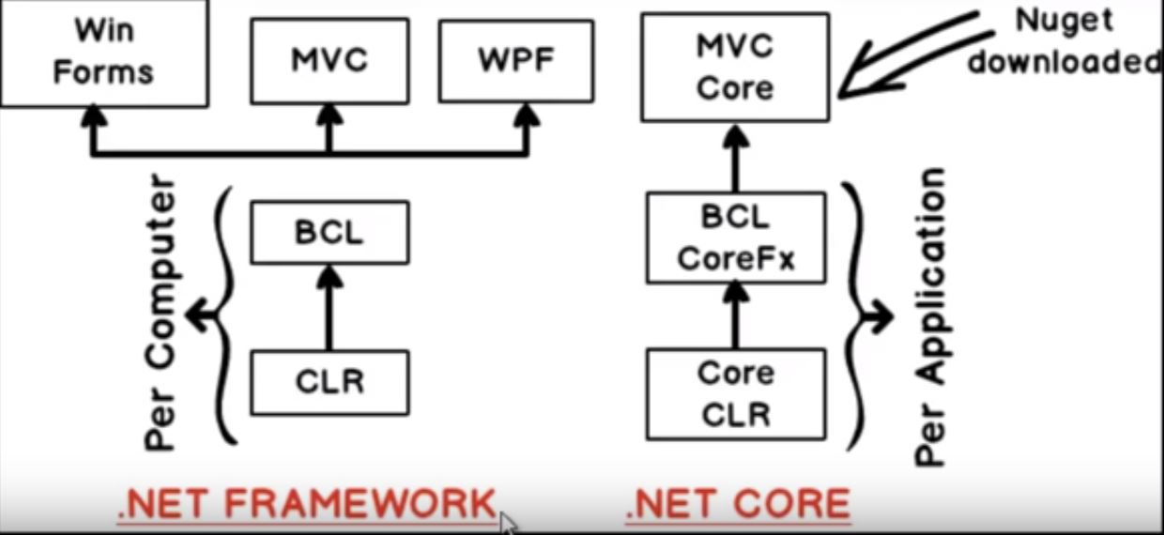
.NET Framework and MVC Core

Slide 4
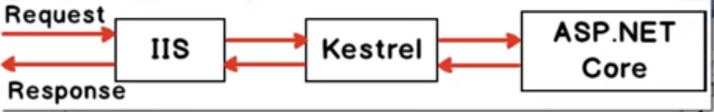
IIS and Kestrel

Slide 5
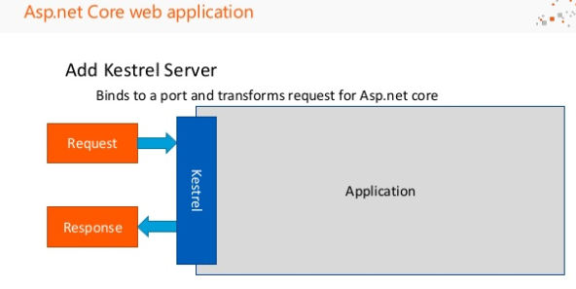

Slide 6
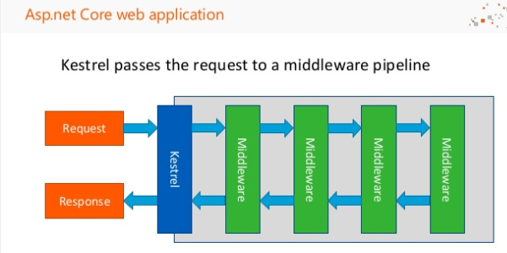

Slide 7
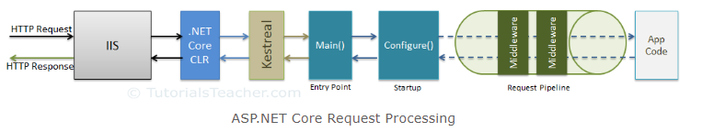
ASP.NET Core - Middleware

Slide 8
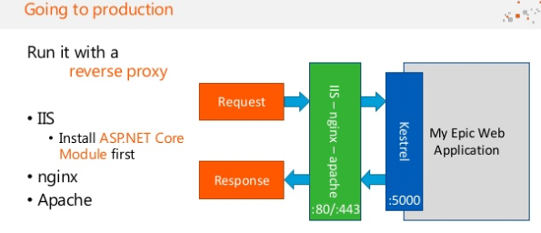

Slide 9
Project

Slide 10
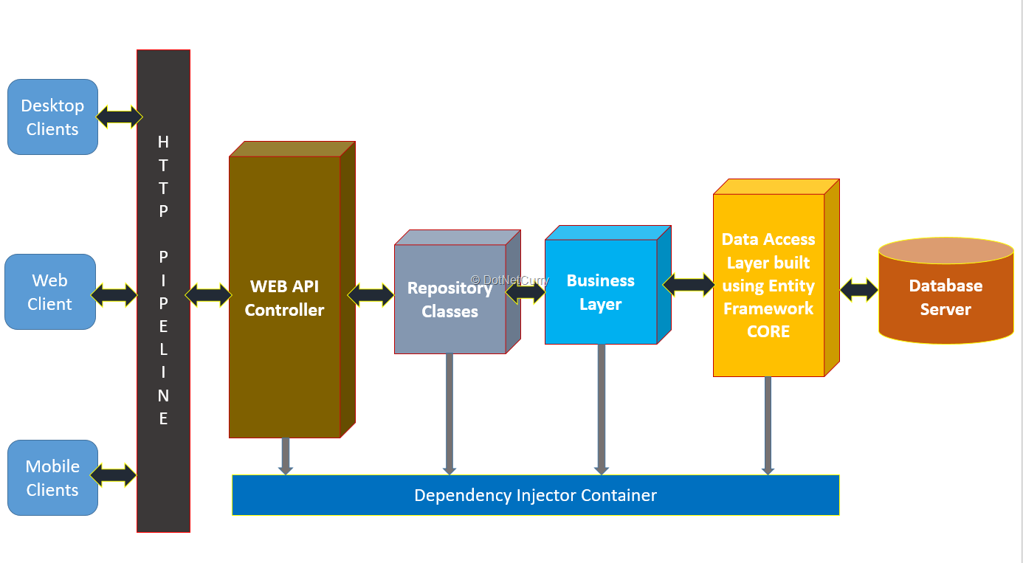
Project Architecture

